Slide 1
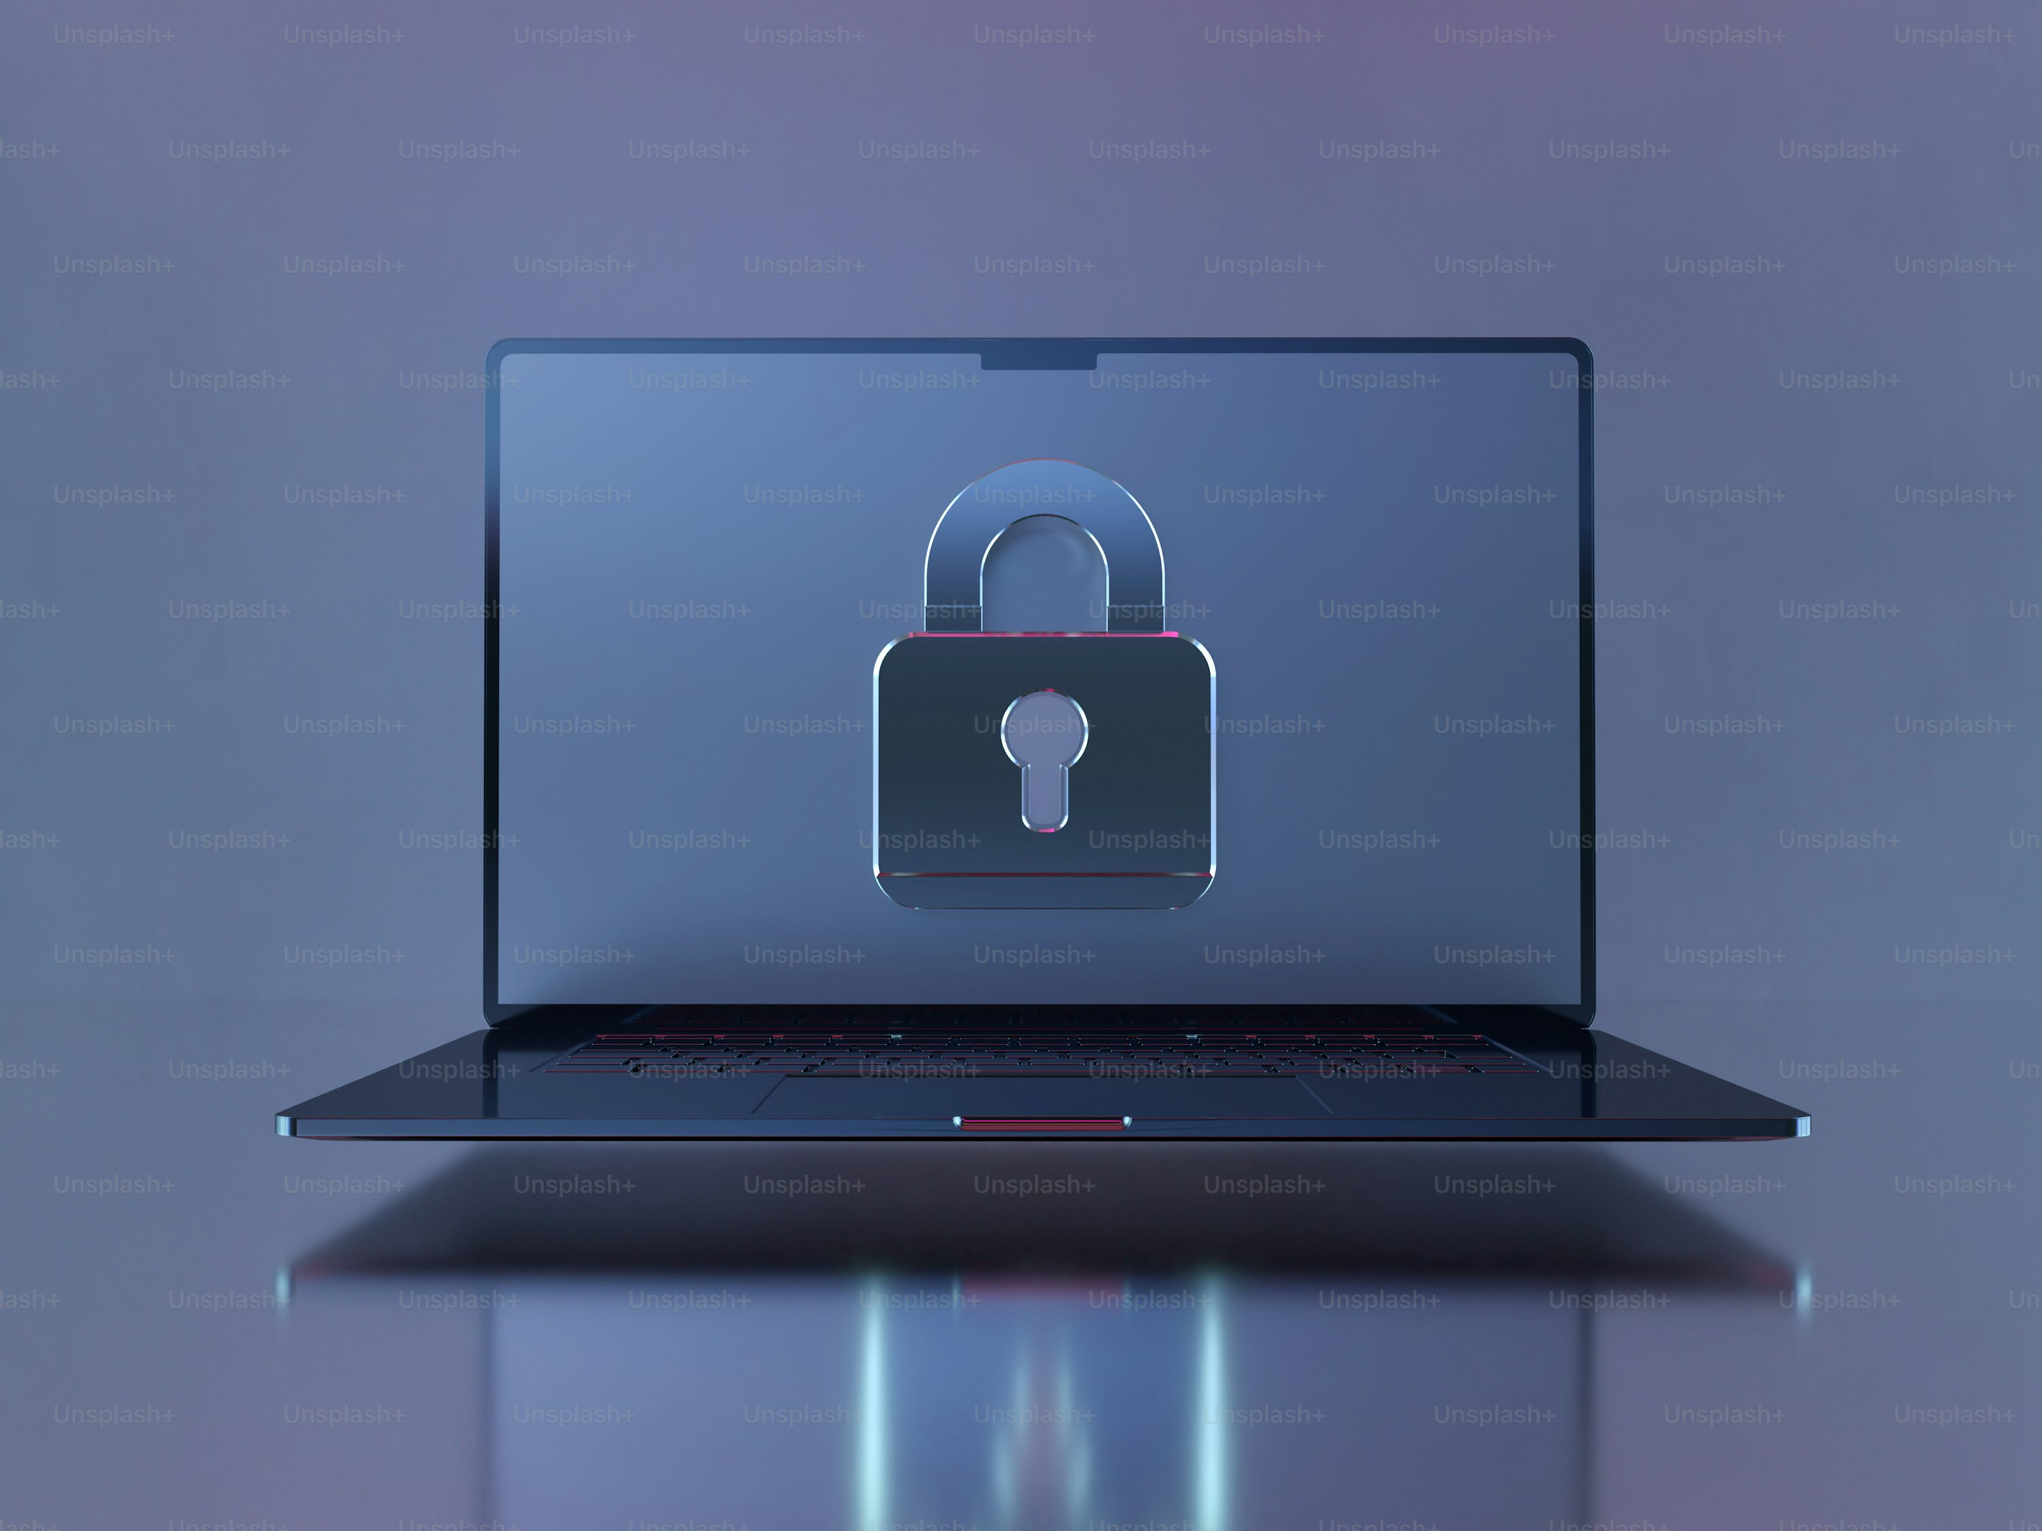
Best Password Manager for Students
Utsav Acharya Computer Science EGR 3350 February 19, 2026
Figure 1:Source: A laptop with a lock on the screen photo – Technology Image on Unsplash

Slide 2
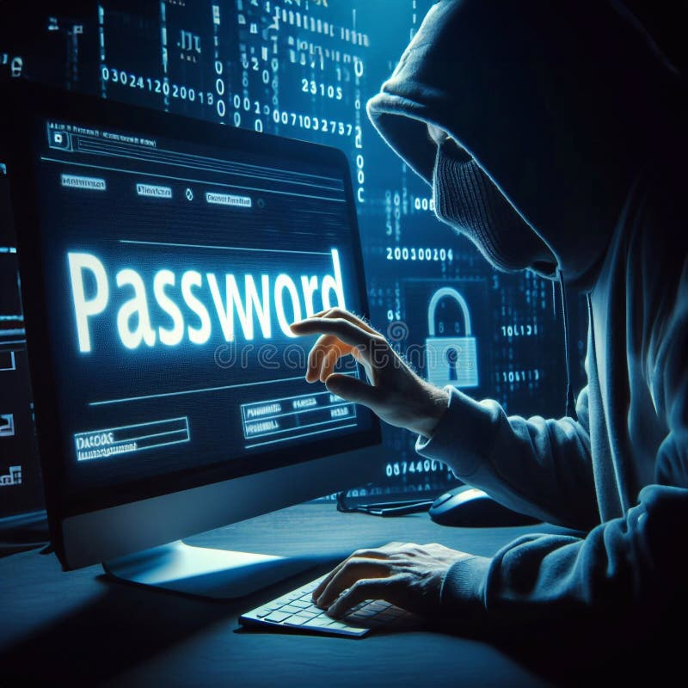
Problem
While working on Wright State University IT department I found many passsword was found on Dark-web.
Many students and employees reuse weak passwords across multiple accounts, which increases the risk of security breaches and unauthorized access.
Organizations need a secure and user-friendly password management solution that helps users store, generate, and protect passwords while maintaining accessibility across devices.
Choosing the wrong solution can lead to security vulnerabilities, data loss, or increased costs.
Figure 2:Source :hacker/password concept) - Search

Slide 3
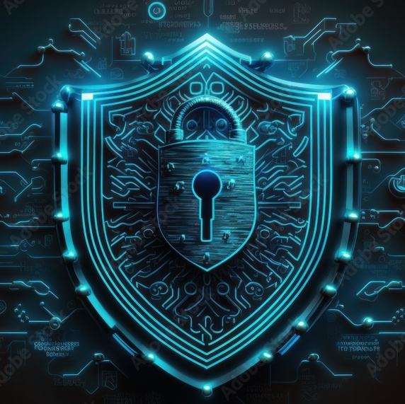
Motivation
This topic relates to Computer Science because cybersecurity and authentication systems are critical areas in modern computing.
Organizations benefit from selecting the right password manager by:
Improving security protection
Reducing password-related support issues
Increasing user productivity
Protecting sensitive data
Figure 3:Source:image: cybersecurity shield - Search Images

Slide 4
Solutions
Three possible password manager solutions include:
Bitwarden
LastPass:
1Password
These tools provide password storage, encryption, and multi-device synchronization.
Source::https://vault.bitwarden.com/
#1 Password Manager & Vault App with Single-Sign On & MFA Solutions - LastPass
Password Manager & Extended Access Management | 1Password | 1Password

Slide 5
Criteria
The solutions will be compared using the following criteria:
Security features (encryption, zero-knowledge architecture)
Cost (student pricing or subscription cost)
Usability (ease of use and compatibility across devices)

Slide 6
Potential Sources
Background Information:
Cybersecurity research articles :Journal of Cybersecurity | Oxford Academic
NIST security guidelines:NIST Recommends New Rules for Password Security
Academic journals:An In-Depth Analysis of Password Managers and Two-Factor Authentication Tools | ACM Computing Surveys
Data Sources:
Official product websites :#1 Password Manager & Vault App with Single-Sign On & MFA Solutions - LastPass
Security reviews and reports : The 2 Best Password Managers of 2026 | Reviews by Wirecutter
Technology comparison websites:The Best Password Managers of 2026: Based On Your Needs | Security.org
Consumer Reports / TechRadar / PCMag :The Best Password Managers We've Tested for 2026 | PCMag
Best password manager of 2026: reviewed, rated, and ranked by the experts | TechRadar
Best Password Manager Reviews – Consumer Reports Reviews – Consumer Reports

